Slide 1

Flight Price Prediction using Machine Learning Approaches
Presenter: Ridima Verma
[AU2149013]

Slide 2

Introduction
There are several factors that can contribute to higher ticket fares for domestic flights in India. Such as:
Fuel Prices
Capacity Constraints
Competition
Seasonal Demand
Currency Fluctuations
Flight fare prediction before booking a flight ticket can be very helpful in several ways:
Cost Savings
Comparison Shopping
Image source: https://www.aionlinecourse.com/blog/airline-tickets-price-prediction

Slide 3
Problem Statement
Flight ticket pricing is important for airlines and passengers. Accurate prediction is necessary to optimize pricing strategies and inform purchasing decisions. However, traditional approaches to prediction are ineffective. This study aims to review various Machine learning techniques and develop a precise prediction model to provide valuable insights for airlines and passengers.

Slide 4
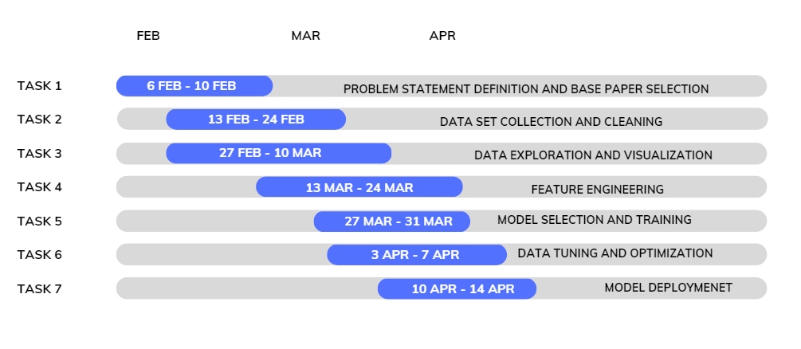
GANTT Chart

Slide 5
Background
Regression-based models such as linear regression, lasso regression, logistic regression, ridge regression, and Elastic net.
Classification-based models such as decision trees, random forest, naive bayes and SVM
Time series analysis such as ARIMA, SARIMA, and Prophet.
Neural network models such as feedforward neural networks, recurrent neural networks, and convolutional neural networks.

Slide 6
Limitations
Limitations for Regression-based models:
Assumes linear relationship between variables.
Limited in handling non-linear interactions between variables.
Sensitive to outliers.
Limitations for Classification-based models:
May suffer from overfitting when the model is too complex and the dataset is too small.
Decision trees are prone to high variance.
Naive Bayes assumes that features are independent.
SVMs may not perform well when the data is not linearly separable.

Slide 7
Limitations
Limitations for Time series analysis:
Assumes that the data is stationary
May not work well when there are abrupt changes in the data
May not perform well when the underlying patterns in the data are not well-defined.
Limitations for Neural network models:
Require a large amount of data to train properly.
Prone to overfitting when the model is too complex and the dataset is too small.
Black box nature of neural networks makes it difficult to interpret how the model is making its predictions.

Slide 8
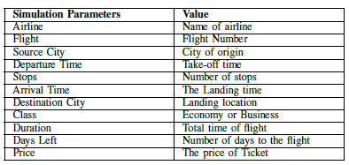
Followed Approach
Data Collection: Extensive data collection is necessary, including airline names, flight sources and destinations, and routes. Two datasets with different attributes are used to build the model.
Feature Selection: The most crucial step is selecting the features that will impact the flight pricing model.
Data Preparation: The data set includes 30,000 data points.
Categorical data were encoded using one hot encoding and label encoding.
The splitting of some attributes was done to make them more useful.
https://www.kaggle.com/code/mehulnayak10/flight-fare-prediction-eda/input
https://www.kaggle.com/code/varunsaikanuri/flight-fare-prediction-10-ml-models/input

Slide 9
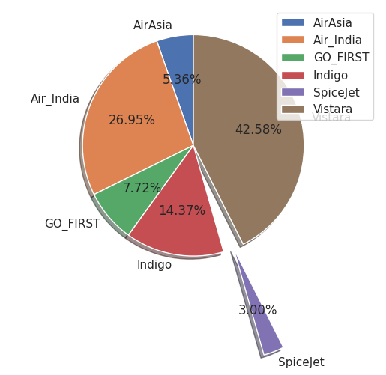
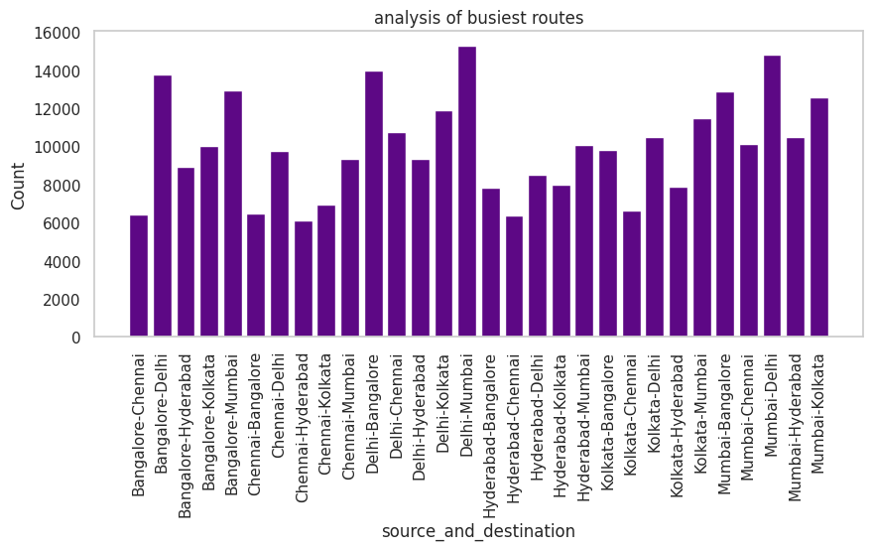
Followed Approach
Model Selection: Choosing the most appropriate model to use.
Training and Testing: The collected data is split into two subgroups, the training set, which is used to develop the model, and the test set, which is used to evaluate the model’s performance.
Data Visualization: Any data collection may be made meaningful by translating it into visuals, a process called data visualization.
Several graphs were presented to analyze different aspects of the data set, including an analysis of various travel destinations, heavily trafficked flight routes, and market shares among different airlines.

Slide 10
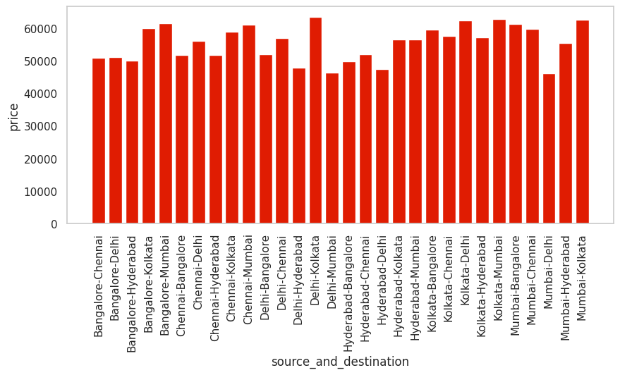
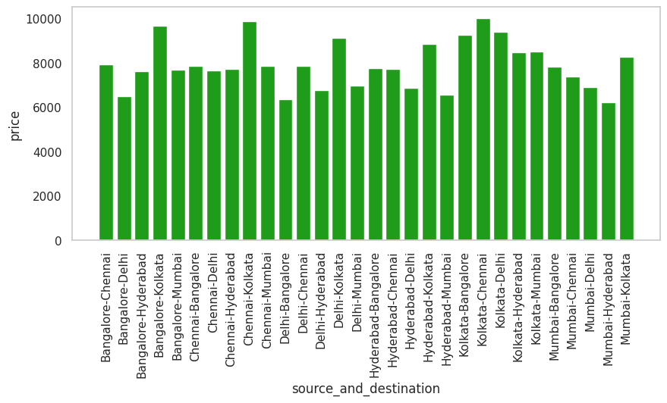
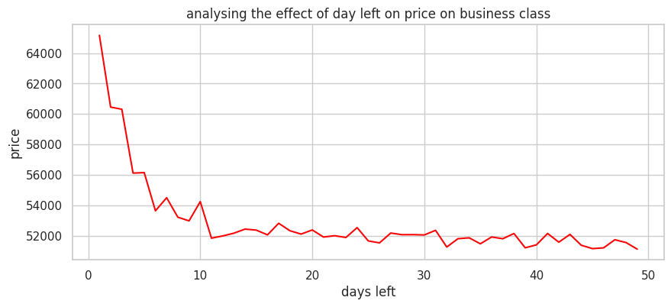
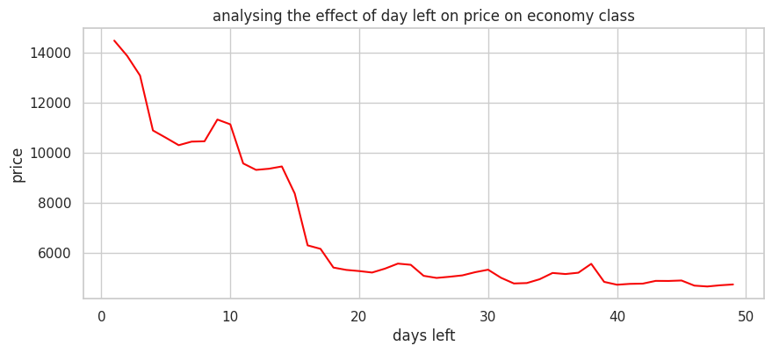
Followed Approach

Slide 11

Final Results
The approach for improving machine learning models is to hyper-tune the models using GridSearchCV or RandomSearchCV.
The best features and settings are identified after hyper-tuning, and the model is trained and evaluated.
The accuracy of the models is compared using performance measures, and the prediction is implemented by taking input from the user.

Slide 12
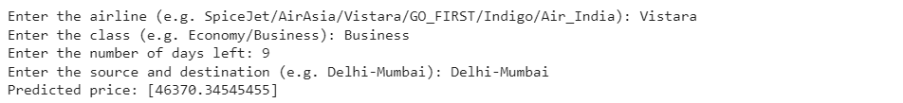
Final Results
The input is taken from the user for the name of the airline, the class, the number of days left, the source, and the destination city. And the value of the ticket fare is predicted.
The given example takes the input of Vistara as the airline name, class as Business, number of days as 9, and Source and Destination as Delhi-Mumbai.

Slide 13
Conclusion
Various regression techniques to predict flight fares were explored such as linear regression, lasso regression, decision tree, and decision tree regressor.
All four methods produced reasonable predictions of flight fares.
The decision tree regressor model performed better than the other models by identifying the most important features in predicting flight fares and producing more accurate predictions.
Regression techniques have potential for predicting flight fares and a combination of these techniques could be used to produce the most accurate predictions depending on the specific needs of the user.

Slide 14
References
[1] W. Groves and M. Gini, ”A regression model for predicting optimal purchase timing for airline tickets,” Technical Report 11-025, University of Minnesota, Minneapolis, 2011.
[2] H.-C. Huang, ”A hybrid neural network prediction model of air ticket sales,” Telkomnika Indonesian Journal of Electrical Engineering, vol. 11, no. 11, pp. 6413–6419, 2013.
[3] M. Papadakis, ”Predicting Airfare Prices,” 2014. Clerk Maxwell.
[4] T. Janssen, ”A linear quantile mixed regression model for prediction of airline ticket prices,” in A Treatise on Electricity and Magnetism 3rd ed., vol. 2, 2014, pp. 68-73
[5] R. Ren, Y. Yang and S. Yuan, ”Prediction of the airline ticket price,” Technical Report, Stanford University, 2014.
[6] Lantseva, Anastasia, Mukhina, Ksenia, Nikishova, Anna, Ivanov, Sergey, Knyazkov and Konstantin, ”Data-driven Modeling of Airlines Pricing,” Procedia Computer Science, vol. 66, pp. 267-276, 2015.
[7] Sha, Z., Moolchandani, K., Panchal, J., Delaurentis, D. (2015). Modeling airline’s decisions on route selection using discrete choice models - data and supplementary material.
[8] Sha, Z., Moolchandani, K., Panchal, J., DeLaurentis, D. (2016). Modeling airlines’ decisions on city-pair route selection using discrete choice models. Journal of Air Transportation, 24, 1–11.
[9] A. Boruah, K. Baruah, B. Das, M. Das, and N. Gohain, ”A Bayesian Approach for Flight Fare Prediction Based on Kalman Filter,” in Progress in Advanced Computing and Intelligent Engineering, Singapore, 2019, pp. 191- 203
[10] William Groves and Maria Gini, ”A regression model for predicting optimal purchase timing for airline tickets.,” Technical report,The University of Minnesota, Minneapolis, USA, Report number 11-025, 2021.

Slide 15
Thank You!
(ridima.v@ahduni.edu.in)

